Slide 1



Three Ways of DevOps
Notes:
[Title Slide]
[Instructions for Facilitator]
The workshop consists of a short talk followed by a workshop session. During the workshop session, the delegates will choose one of three groups: Gods, Reporters or Geniuses.
You will need three places for your workgroups to gather and collate their ideas, so three sets of postits and/or three flipcharts would be ideal (flipcharts are easiest for feedback session at the end)
You can run this solo but it works best if there are three facilitators, one for each work group to help encourage everyone to participate. During the work group time, the best ideas come out if the presenter/facilitator steps away for a bit, then walks round with encouragement and to answer any questions, about half way through,
This can be run for any length of time between half an hour and two hours. Around one hour is ideal.

Slide 2

I am…
Name
Role
Company
Email:
Image of
Facilitator

Slide 3
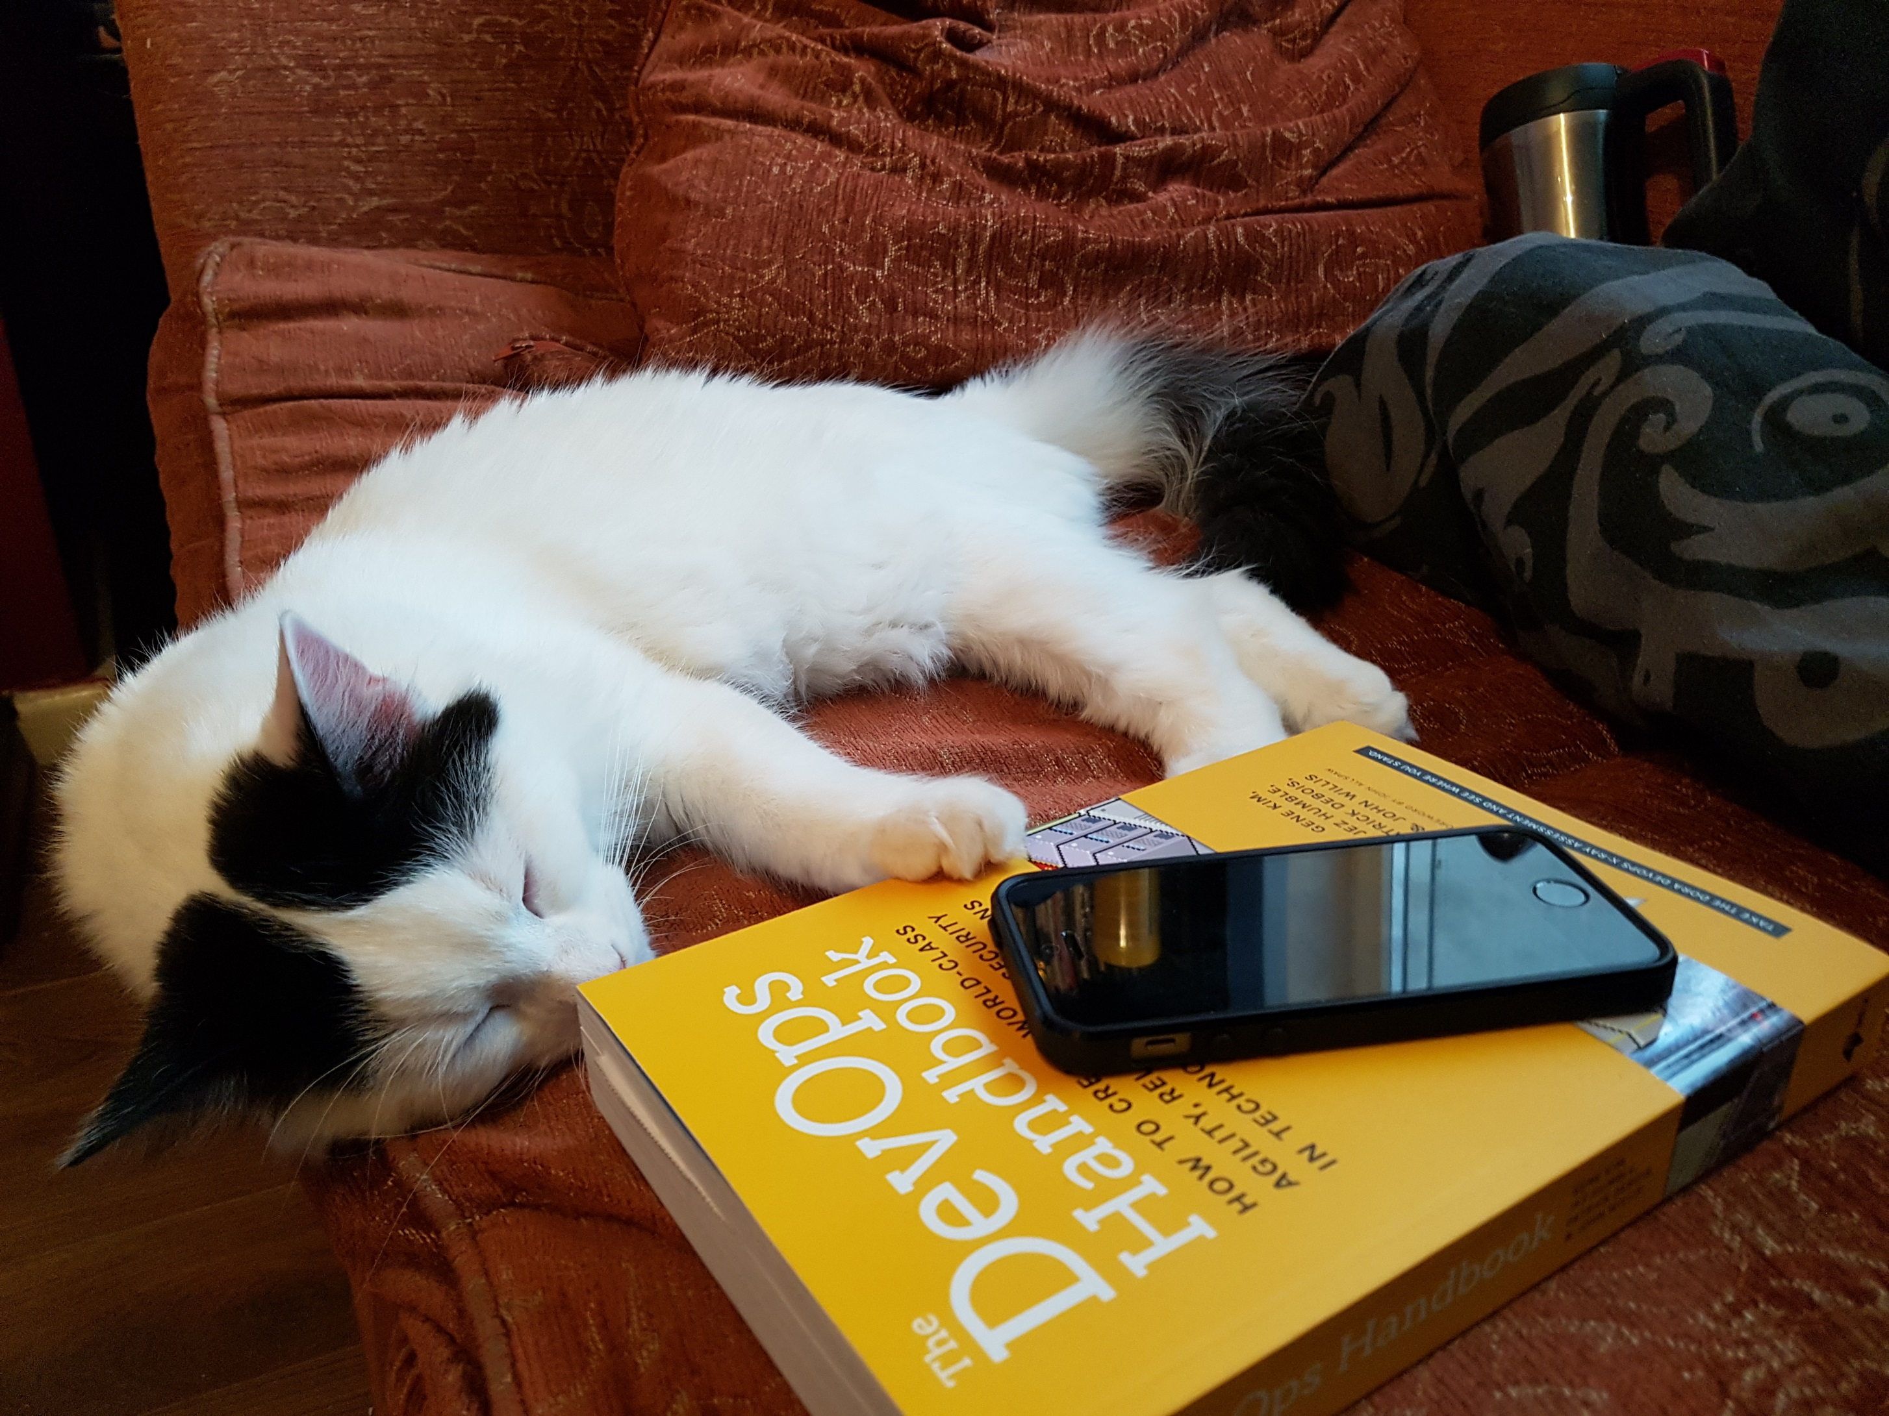
Notes:
Quick question to the room to gauge who is in the room? Dev? Ops? Test? Sec? Sales? Tech Consultants? Architects? Support?
How much do they already know of DevOps? We’re going to talk a bit about the principles of DevOps today. First, the CALMS model and then the main focus of this workshop, the Three Ways of DevOps.
Don’t worry about taking everything in, just relax and listen for now. After a really short talk, we’ll split up into three groups and talk about ways we can all apply the Three Ways in our work, it’s not just for Dev and Ops.
(By the end of this, you’ll love it as much as Rollins the cat)

Slide 4
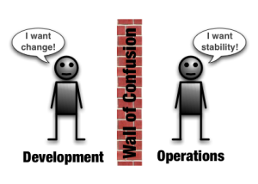
Notes:
What’s the Point of DevOps?
This might be a slide you’ve seen a few times before and it is a brilliant, very much oversimplified way of describing the original problem that DevOps was designed to address. Devs writing code, want their changes into prod. Ops don’t want prod to break.
That‘s often more about the way the teams are incentivised; Devs are paid to create new features whereas Ops usually have targets around uptime/availability.
How can we have both change and stability…
(Can talk about the history of DevOpsDays a bit as well if there’s time)

Slide 5
Culture
Automation
Lean
Measurement
Sharing
Notes:
Ultra briefly talk through the CALMS model, emphasising the points you feel are most relevant to the specific audience.

Slide 6


“3 ways” of DevOps
Dev
Ops
Dev
Ops
Dev
Ops
Notes:
The concept of three underpinning ways of DevOps was described in “The Phoenix Project” by Gene Kim, Kevin Behr and George Spafford. These are the focus of this workshop –
Again, don’t worry about remembering everything just now, just let the ideas flow and all the info you need will be available at the end.
Each of these arrows represents a flow of activity, value and communication. Let’s break each one down.
For each Way, we’re going to assign a personality to it. As we go through, if there’s a particular personality that jumps out at you, as one you identify with or are curious about – maybe you’d like to join that group when we break out into work groups.

Slide 7
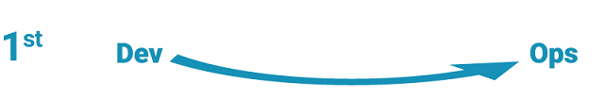
The First Way
Systems Thinking
Notes:
The First Way
Emphasizes the performance of the entire system, as opposed to the performance of a specific silo of work or department.
Outcomes
- Never passing a known defect to downstream work centres
- Never allowing local optimization to create global degradation
- Always seeking to increase flow
- Always seeking to achieve profound understanding of the system
The First way is like being a GOD; you are everywhere, you see everything, the good and the bad. You seek to improve…

Slide 8
The Second Way
Amplify Feedback Loops
Ops
Dev
Notes:
The Second Way
With almost any process improvement initiative, the goal is to shorten and amplify feedback loops so necessary corrections can be continually made.
Outcomes
- Understanding and responding to all customers, internal and external
- Shortening and amplifying all feedback loops
- Embedding knowledge where you need it
The second way is like being a passionate, investigative REPORTER, you’re driven to make sure that you have the right information and that it gets to the right people, in the most relevant and interesting way

Slide 9

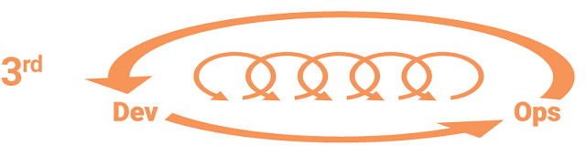
The Third Way
Culture of continual experimentation and learning
Notes:
The Third Way
Involves creating a culture that fosters two things:
- Continual experimentation, which requires taking risks and learning from success and failure
- Understanding that repetition and practice are the prerequisites to mastery
Outcomes
- Allocating time for the improvement of daily work
- Creating rituals that reward the team for taking risks
- Introducing faults into the system to increase resilience
The Third Way is like being a scientist, a GENIUS, who is compelled to continuously experiment, to learn and progress.

Slide 10

Gods
The First Way
Systems Thinking
The Second Way
Reporters
Amplify Feedback Loops
The Third Way
Geniuses
Culture of continual experimentation and learning
Notes:
[This slide is animated ‘on click’ for the words Gods, Reporters, Geniuses to appear]
Time to split up into your three groups – Think about the ‘way’ that you have chosen; what ideas do you have – or what changes could you make in your organisation which will facilitate and promote your way.
In DevOps, you need all three of these for success! But right now, just go with yours
I will leave a video loop playing so that you can get a reminder of each ‘way’ and what it means, if you need it. Don’t be too tied down by these definitions – just write down any ideas for improvement as they occur to you.
(Direct participants to their flipcharts or whiteboards)
You have x minutes – please feel free to ask anything as you go

Slide 11

Notes:
[This slide is not blank; Video will play automatically. Leave it on the screen while the groups compile their ideas]

Slide 12
Gods
The First Way
Systems Thinking
The Second Way
Reporters
Amplify Feedback Loops
The Third Way
Geniuses
Culture of continual experimentation and learning
Notes:
Feedback from each group, get them to talk through their ideas briefly

Slide 13

Header
Notes:
Thank you and please come forward with any questions

Slide 14

Questions?
Notes:
You can use this slide if you have time for a proper Q&A at the end

Slide 15
Notes:
[Slide Intentionally Blank]
If you’re running this workshop with (a) specific department(s), you might find one or more of the following slides useful, so slot them in if you want!

Slide 16

Dev Teams
…
Notes:
Want freedom to innovate
Would like to interact with other teams but don’t want frequent interruptions (productivity graph)
No need to worry because the testing is robust and will catch issues before they escape into the wild and cause problems/blame/stress
What I’m doing is real and relevant because it could be live in hours
Can see my code working in live and if it doesn’t work I feel responsibility

Slide 17

Ops Teams
…
Notes:
Want software to be Operable: Reliable, Predictable, Maintainable
Want to be able to sleep at night – you’ll know if something’s wrong way before the customers do. You want to trust that alerts will occur at the right severity level
Want to get fixes into live as quickly as possible without causing new issues
Space to look at improving and upgrading in my own world rather than frustrating firefighting. I can make the most of opportunities, not just deal with problems

Slide 18

Support Teams
…
Notes:
Want to be able to log incidents and defects, see progress on them without bothering the other people working on them
Have a mechanism to get updates about these when needed
Can give accurate, confidence inspiring updates to customers
Able to access enough info and expertise to identify underlying problems
Able to get fixes out to customers swiftly
Confidence in what you can promise

Slide 19


Sales Teams
…
Notes:
Can trust that the products are going to do what I’ve told the customer it’ll do (as long as I didn’t embellish!)
I can show metrics to prove the systems
I can show demos or walking skeletons to customers quickly
Sales pipeline will in part mirror the Delivery pipeline
My customers will be happy with that which they’ve purchased
I can show my customers evidence of innovation and best practice
All the info I need is available to me and I understand it fully

Slide 20


Finance, Human Resources
…
Notes:
All of these guys will have different requirements but they can ‘do’ DevOps too…
Products are developed in a timely and predictable way
Financial forecasting is relatively easy to do following logical steps and patterns
The business is running efficiently
Our day to day tasks are automated where possible and recorded in appropriate, well-maintained systems
Colleagues are motivated and feel that they are well treated
We can understand what other departments are doing – transparency, trust, communication

Slide 21




Upper Management
…
Notes:
Code that’s not doing anything costs money
Risk is bad for business - AUDIT
Want ideas pushed quickly through – Business as a market leader, business responding to market forces etc… agility
Do not want bottlenecks and inefficiency – need turnover, need profit ebitda
Want to attract the right staff and retain them

